Slide 1
The Ethics of a University
J. Bradford Delong
http://bradford-delong.com
brad.delong@gmail.com
@delong
2020-05-17 last updated
key: < https://www.icloud.com/keynote/00X6eH3Xld8s6V5ODksUTZkcQ>
github: <https://github.com/braddelong/public-files/blob/master/lecture-optional-ethics-university.pptx>
html: <http://www.bradford-delong.com/2018/06/lecture-a-liberal-education.html>

Slide 2
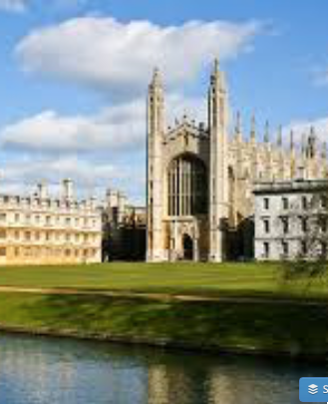
The Ethics of a University
Never thought this was necessary before…
It probably still isn’t necessary today…
But this past decade has been a very weird, very norm-breaking decade in a lot of ways
So it is best to be clear on what we are doing here…
This is a university…

Slide 3
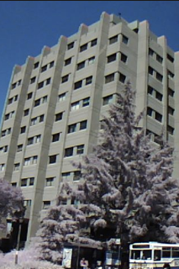
A University Is a Safe Space for Scholars
We all belong here
We all deserve to be treated with respect
We all deserve to be listened to
We all deserve to speak
We all deserve to be taught how to listen better
We all deserve to be taught how to speak better
We all deserve to be taught how to think better
Don’t set out to diss others
Don’t diss yourself

Slide 4
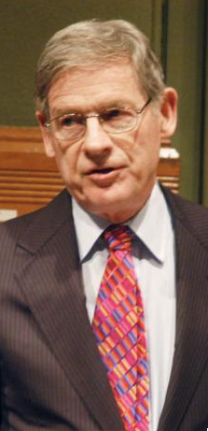
Responsibilities to Other Members of the University
Don’t be like Harvey Mansfield!
Harvey Mansfield:
“Everyone knows that C is an average grade…. Grade inflation got started… [when] white professors, imbibing the spirit of affirmative action, stopped giving low or average grades to black students and, to justify or conceal it, stopped giving those grades to white students as well…”
“You should keep your office door closed here. If you don’t, undergraduates might wander in…”

Slide 5
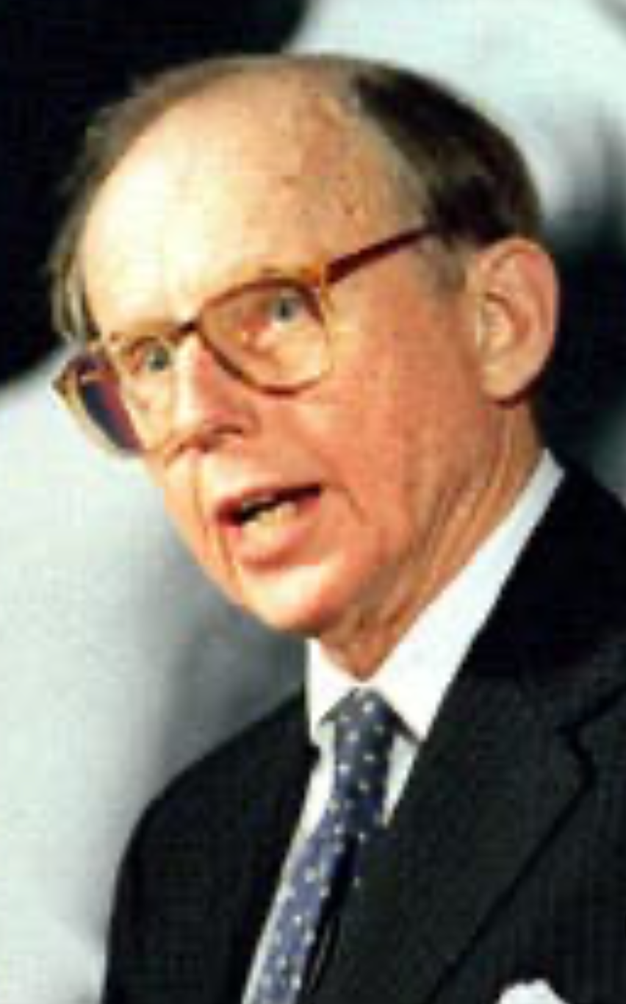
Responsibilities to Society at Large
Don’t be like Sam Huntington!
Sam Huntington:
“Unlike past immigrant groups, Mexicans and other Latinos have not assimilated… rejecting the Anglo-Protestant values that built the American dream.... The Hispanization of Miami is without precedent.... The Cuban takeover.... Anglos (as well as blacks)... [became] outside minorities… unable to communicate with… bureaucrats… discriminated against by store clerks… Anglos... could accept… subordinat[ion]... assimilate into the Hispanic community... or... leave... their exodus reflected in a popular bumper sticker: 'Will the last American to leave Miami, please bring the flag’...”

Slide 6
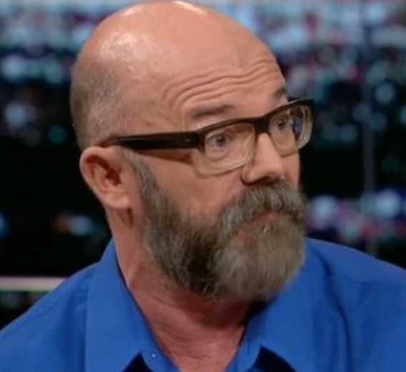
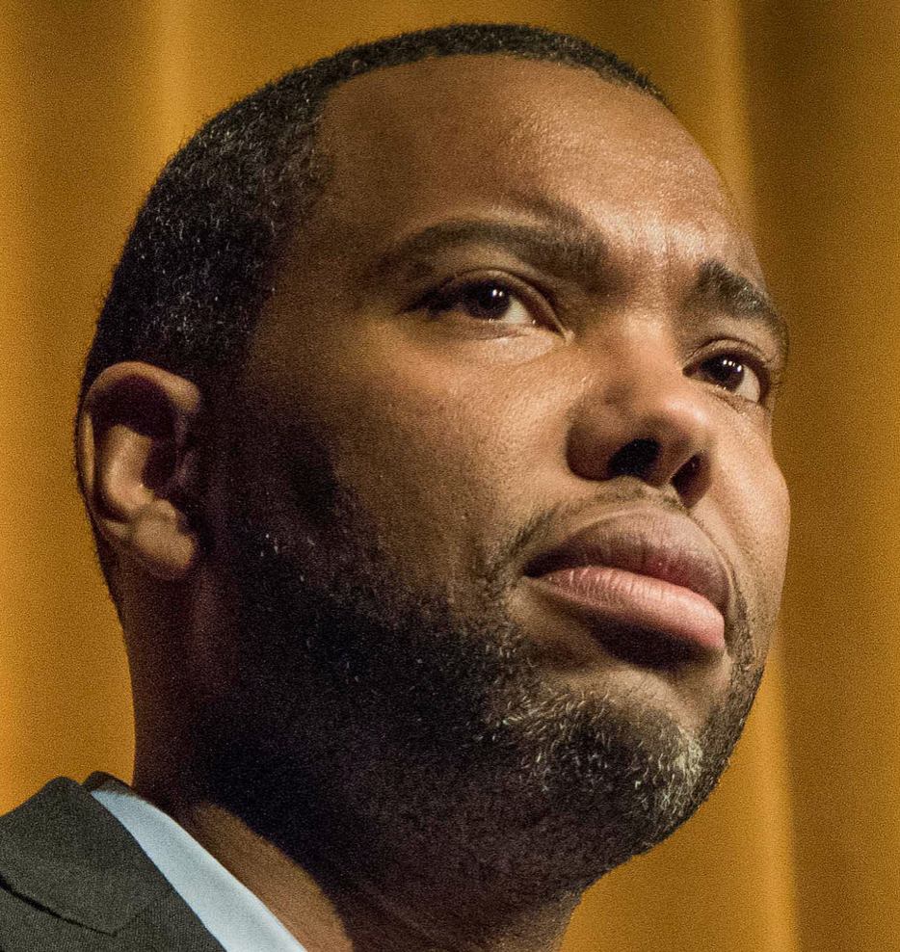
Think About & Know What You Are Saying!
Andrew Sullivan (2018): “Ta-Nehisi and I... there was a civility about it, an actual generosity of spirit, that transcended the boundaries of race and background.... Our engagement with each other and our readerships was a crackling and productive one… before Twitter swallowed blogging, before identity politics became completely nonnegotiable, before we degenerated into these tribal swarms of snark and loathing…”
Ta-Nehisi Coates (2018): “I got incredibly used to learning from people... quite good at their craft, who I felt, and pardon my language, were f***ing racist. And that was just the way the world was. I didn’t really have the luxury of having teachers who I necessarily felt, you know, saw me completely as a human being.... Me arguing with Andrew Sullivan about whether black people are genetically disposed to be dumber than white people. I actually had to take this seriously, you understand? I couldn’t speak… to Andrew on the blog the way I would speak to my wife about what Andrew said on the blog in the morning when it was just us…”

Slide 7

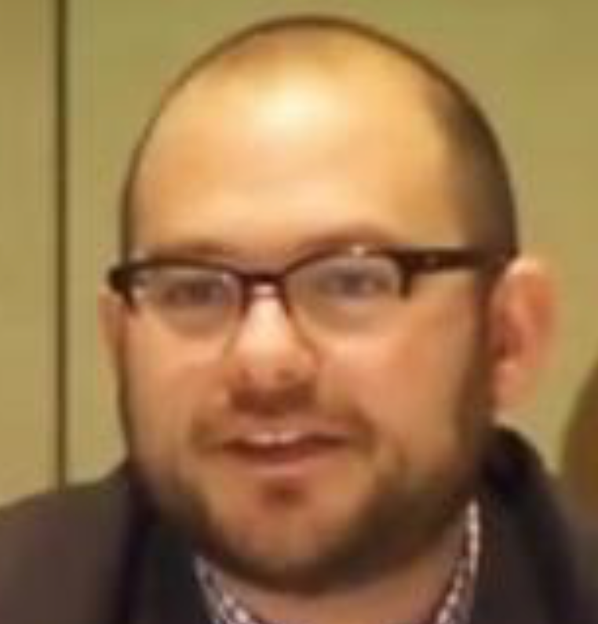
Think About & Know What You Are Saying! II
Henry Farrell (2018): “Sullivan’s and Coates’s pieces provide a miniature history of how a certain variety of self-congratulatory openness to inquiry is in actual fact a barbed thicket of power relations. What Sullivan depicts as… ’civility' and 'generosity of spirit’… [is] Coates’s 'teachers' who didn’t see him 'completely as a human being'. What was open and free spirited debate in Sullivan’s depiction, was to Coates a loaded and poisonous dialogue where he could only participate if he shut up about what he actually believed…”
Andrew Sullivan (2001): “The Krugmans and the Chaits will shortly have a cow, if not a whole herd of them.… Some commentators… get steamed because Bush has… claimed his tax cut will cost less than it actually will, or because he is using Medicare surplus money today that will be needed tomorrow and beyond…. The deeper point… [is] that Bush has to obfuscate his real goals of reducing spending with the smoke screen of ‘compassionate conservatism’ … [in his] uphill… struggle is…”
Matthew Yglesias (2005): “Andrew Sullivan… consistent proponent… that Paul Krugman is some sort of liar… [because of his] repeated insistences that George W. Bush's economic policy is founded on a tissue of lies…. The unnoted irony here is that … [on] May 14, 2001… Sullivan conceded Krugman's point…”

Slide 8
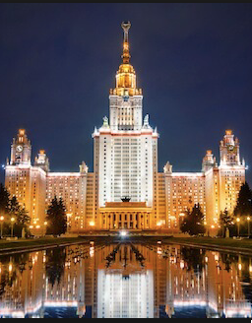
A University Is a Safe Space for Ideas
The purpose of a university is to generate, examine, and assess ideas
It is antithetical for outsiders or insiders to limit ideas generated
It is also antithetical not to examine and assess ideas seriously and honestly
This is a very delicate balancing act
what ideas—left to “your conscience and your god” (Kantorowicz)
how to treat them—norms of scholarship
Cf: <http://delong.typepad.com/delong_long_form/2016/05/the-economist-as-the-public-square-and-economists.html>

Slide 9
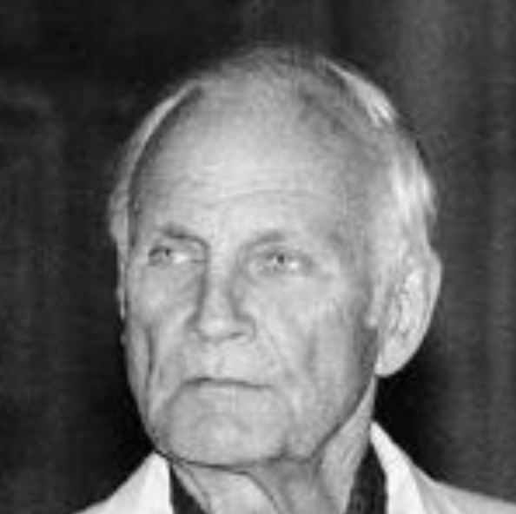
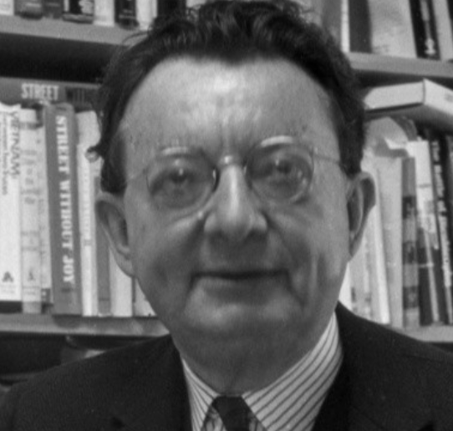
Responsibilities to Ideas
Don’t be like Paul Sweezy!
Q: “[Your] editorial after Stalin died in 1953, for instance, called him one of the greatest men in history, I believe…
Paul Sweezy: “Something like that. Well, in some ways he was, but he had his underside, too. I guess one should have been more cautious, but I think you had to take positions which were pretty much unambiguous. Either you were for or against the regimes, the actually existing socialist countries…. Early on there was a position… that the Soviet Union was an ideal new society. Gradually one had to get over that. But not by turning around, becoming an enemy, joining the other side. That's always a difficult line to follow, I think, but it's absolutely essential…”
Contrast with I.F. Stone: “After seeing the Soviet Union and studying the statements of its leading officials: This is not a good society and it is not led by honest men. No society is good in which men fear to think--much less speak--freely. I don't care how many tons of steel the Russians produce…”

Slide 10
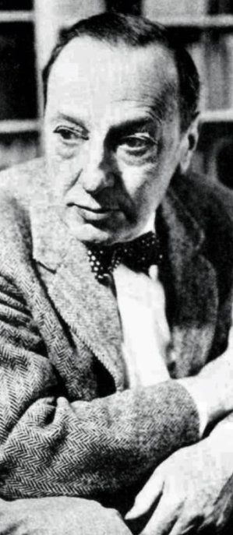
The University of California Loyalty Oath
Do be like Ernst Kantorowicz:
“Three professions… wear a gown: the judge, the priest, the scholar. This garment stands for its bearer's maturity of mind, his independence of judgment, and his direct responsibility to his conscience and to his God….
“It is a shameful and undignified action,
it is an affront and a violation of both human sovereignty and professional dignity
that the Regents of this University have dared to bully the bearer of this gown into a situation in which—under the pressure of a bewildering economic coercion—
he is compelled to give up either his tenure or, together with his freedom of judgment, his human dignity and his responsible sovereignty as a scholar…
<http://www.lib.berkeley.edu/uchistory/archives_exhibits/loyaltyoath/symposium/kantorowicz.html>

Slide 11
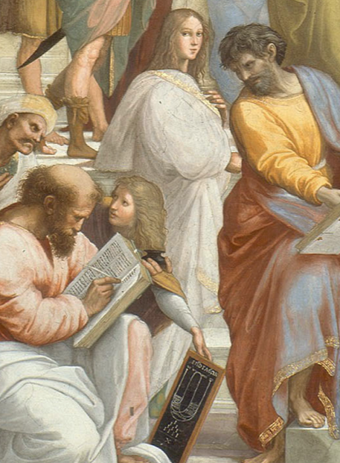
So Learn!: Extend Your Brains in Every Direction Your Curiosity Moves You
References in this lecture you may not be familiar with:
“Avicenna”: Peter Beagle (1987): The Folk of the Air <http://amzn.to/1PvCcdN>.
Ibn Sina: Abū ʿAlī al-Ḥusayn ibn ʿAbd Allāh ibn Al-Hasan ibn Ali ibn Sīnā <http://tinyurl.com/n58rjc6>
“State of Euphoria”: David Lodge (1975): Changing Places <http://amzn.to/1nhoXXp>.
Enkidu: Gilgamesh <http://amzn.to/1PepdkP>.
Fujiwara Takako: Genji Monogatari <http://amzn.to/1nhCkXy>.
Hypatia <http://tinyurl.com/z9uyqy>:
Ibn Khaldun: Abū Zayd ‘Abd ar-Raḥmān ibn Muḥammad ibn Khaldūn al-Ḥaḍramī, Muquaddimah <http://amzn.to/1Sd0uhv>.
Odysseus: <http://amzn.to/1nhCA94>.

Slide 12
Catch Our Breath…
What’s up next?
Comments?
Questions?

